Slide 1
Chapter 7 Single-Dimensional Arrays

Slide 2
Opening Problem
Read one hundred numbers, compute their average, and find out how many numbers are above the average.

Slide 3
Objectives
To describe why arrays are necessary in programming (§7.1).
To declare array reference variables and create arrays (§§7.2.1–7.2.2).
To obtain array size using arrayRefVar.length and know default values in an array (§7.2.3).
To access array elements using indexes (§7.2.4).
To declare, create, and initialize an array using an array initializer (§7.2.5).
To program common array operations (displaying arrays, summing all elements, finding the minimum and maximum elements, random shuffling, and shifting elements) (§7.2.6).
To simplify programming using the foreach loops (§7.2.7).
To apply arrays in application development (AnalyzeNumbers, DeckOfCards) (§§7.3–7.4).
To copy contents from one array to another (§7.5).
To develop and invoke methods with array arguments and return values (§§7.6–7.8).
To define a method with a variable-length argument list (§7.9).
To search elements using the linear (§7.10.1) or binary (§7.10.2) search algorithm.
To sort an array using the selection sort approach (§7.11).
To use the methods in the java.util.Arrays class (§7.12).
To pass arguments to the main method from the command line (§7.13).

Slide 4
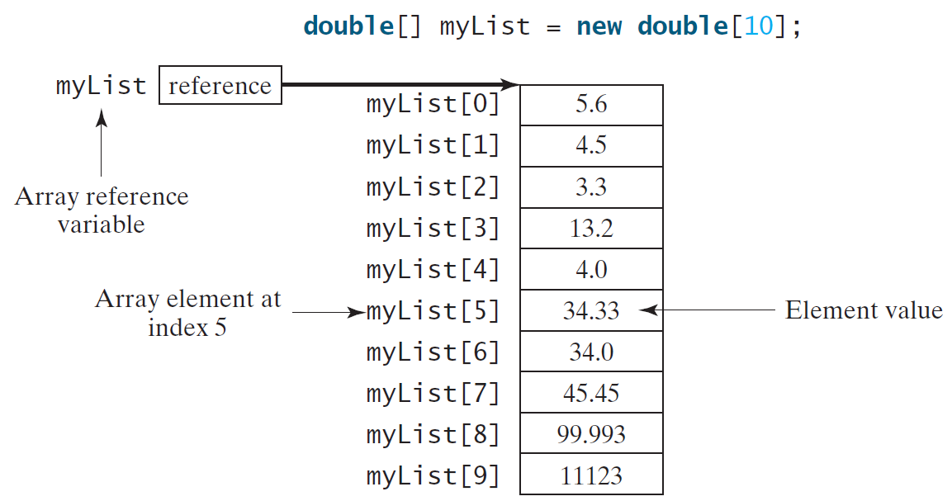
Introducing Arrays
Array is a data structure that represents a collection of the same types of data.

Slide 5
Declaring Array Variables
datatype[] arrayRefVar;
Example:
double[] myList;
datatype arrayRefVar[]; // This style is allowed, but not preferred
Example:
double myList[];

Slide 6
Creating Arrays
arrayRefVar = new datatype[arraySize];
Example:
myList = new double[10];
myList[0] references the first element in the array.
myList[9] references the last element in the array.

Slide 7
Declaring and Creating in One Step
datatype[] arrayRefVar = new
datatype[arraySize];
double[] myList = new double[10];
datatype arrayRefVar[] = new datatype[arraySize];
double myList[] = new double[10];

Slide 8
The Length of an Array
Once an array is created, its size is fixed. It cannot be changed. You can find its size using
arrayRefVar.length
For example,
myList.length returns 10

Slide 9
Default Values
When an array is created, its elements are assigned the default value of
0 for the numeric primitive data types,
'\u0000' for char types, and
false for boolean types.

Slide 10
Indexed Variables
The array elements are accessed through the index. The array indices are 0-based, i.e., it starts from 0 to arrayRefVar.length-1. In the example in Figure 6.1, myList holds ten double values and the indices are from 0 to 9.
Each element in the array is represented using the following syntax, known as an indexed variable:
arrayRefVar[index];

Slide 11
Using Indexed Variables
After an array is created, an indexed variable can be used in the same way as a regular variable. For example, the following code adds the value in myList[0] and myList[1] to myList[2].
myList[2] = myList[0] + myList[1];

Slide 12
Array Initializers
Declaring, creating, initializing in one step:
double[] myList = {1.9, 2.9, 3.4, 3.5};
This shorthand syntax must be in one statement.

Slide 13
Declaring, creating, initializing Using the Shorthand Notation
double[] myList = {1.9, 2.9, 3.4, 3.5};
This shorthand notation is equivalent to the following statements:
double[] myList = new double[4];
myList[0] = 1.9;
myList[1] = 2.9;
myList[2] = 3.4;
myList[3] = 3.5;

Slide 14
Trace Program with Arrays
animation
Declare array variable values, create an array, and assign its reference to values
public class Test {
public static void main(String[] args) {
int[] values = new int[5];
for (int i = 1; i < 5; i++) {
values[i] = i + values[i-1];
}
values[0] = values[1] + values[4];
}
}

Slide 15
Trace Program with Arrays
animation
i becomes 1
public class Test {
public static void main(String[] args) {
int[] values = new int[5];
for (int i = 1; i < 5; i++) {
values[i] = i + values[i-1];
}
values[0] = values[1] + values[4];
}
}

Slide 16
Trace Program with Arrays
animation
i (=1) is less than 5
public class Test {
public static void main(String[] args) {
int[] values = new int[5];
for (int i = 1; i < 5; i++) {
values[i] = i + values[i-1];
}
values[0] = values[1] + values[4];
}
}

Slide 17
Trace Program with Arrays
animation
After this line is executed, value[1] is 1
public class Test {
public static void main(String[] args) {
int[] values = new int[5];
for (int i = 1; i < 5; i++) {
values[i] = i + values[i-1];
}
values[0] = values[1] + values[4];
}
}

Slide 18
Trace Program with Arrays
animation
After i++, i becomes 2
public class Test {
public static void main(String[] args) {
int[] values = new int[5];
for (int i = 1; i < 5; i++) {
values[i] = i + values[i-1];
}
values[0] = values[1] + values[4];
}
}

Slide 19
Trace Program with Arrays
animation
i (= 2) is less than 5
public class Test {
public static void main(String[] args) {
int[] values = new int[5];
for (int i = 1; i < 5; i++) {
values[i] = i + values[i-1];
}
values[0] = values[1] + values[4];
}
}

Slide 20
Trace Program with Arrays
animation
After this line is executed,
values[2] is 3 (2 + 1)
public class Test {
public static void main(String[] args) {
int[] values = new int[5];
for (int i = 1; i < 5; i++) {
values[i] = i + values[i-1];
}
values[0] = values[1] + values[4];
}
}

Slide 21
Trace Program with Arrays
animation
After this, i becomes 3.
public class Test {
public static void main(String[] args) {
int[] values = new int[5];
for (int i = 1; i < 5; i++) {
values[i] = i + values[i-1];
}
values[0] = values[1] + values[4];
}
}

Slide 22
Trace Program with Arrays
animation
i (=3) is still less than 5.
public class Test {
public static void main(String[] args) {
int[] values = new int[5];
for (int i = 1; i < 5; i++) {
values[i] = i + values[i-1];
}
values[0] = values[1] + values[4];
}
}

Slide 23
Trace Program with Arrays
animation
After this line, values[3] becomes 6 (3 + 3)
public class Test {
public static void main(String[] args) {
int[] values = new int[5];
for (int i = 1; i < 5; i++) {
values[i] = i + values[i-1];
}
values[0] = values[1] + values[4];
}
}

Slide 24
Trace Program with Arrays
animation
After this, i becomes 4
public class Test {
public static void main(String[] args) {
int[] values = new int[5];
for (int i = 1; i < 5; i++) {
values[i] = i + values[i-1];
}
values[0] = values[1] + values[4];
}
}

Slide 25
Trace Program with Arrays
animation
i (=4) is still less than 5
public class Test {
public static void main(String[] args) {
int[] values = new int[5];
for (int i = 1; i < 5; i++) {
values[i] = i + values[i-1];
}
values[0] = values[1] + values[4];
}
}

Slide 26
Trace Program with Arrays
animation
After this, values[4] becomes 10 (4 + 6)
public class Test {
public static void main(String[] args) {
int[] values = new int[5];
for (int i = 1; i < 5; i++) {
values[i] = i + values[i-1];
}
values[0] = values[1] + values[4];
}
}

Slide 27
Trace Program with Arrays
animation
After i++, i becomes 5
public class Test {
public static void main(String[] args) {
int[] values = new int[5];
for (int i = 1; i < 5; i++) {
values[i] = i + values[i-1];
}
values[0] = values[1] + values[4];
}
}

Slide 28
Trace Program with Arrays
animation
i ( =5) < 5 is false. Exit the loop
public class Test {
public static void main(String[] args) {
int[] values = new int[5];
for (int i = 1; i < 5; i++) {
values[i] = i + values[i-1];
}
values[0] = values[1] + values[4];
}
}

Slide 29
Trace Program with Arrays
animation
After this line, values[0] is 11 (1 + 10)
public class Test {
public static void main(String[] args) {
int[] values = new int[5];
for (int i = 1; i < 5; i++) {
values[i] = i + values[i-1];
}
values[0] = values[1] + values[4];
}
}

Slide 30
Enhanced for Loop (for-each loop)
JDK 1.5 introduced a new for loop that enables you to traverse the complete array sequentially without using an index variable. For example, the following code displays all elements in the array myList:
for (double value: myList)
System.out.println(value);
In general, the syntax is
for (elementType value: arrayRefVar) {
// Process the value
}
You still have to use an index variable if you wish to traverse the array in a different order or change the elements in the array.

Slide 31
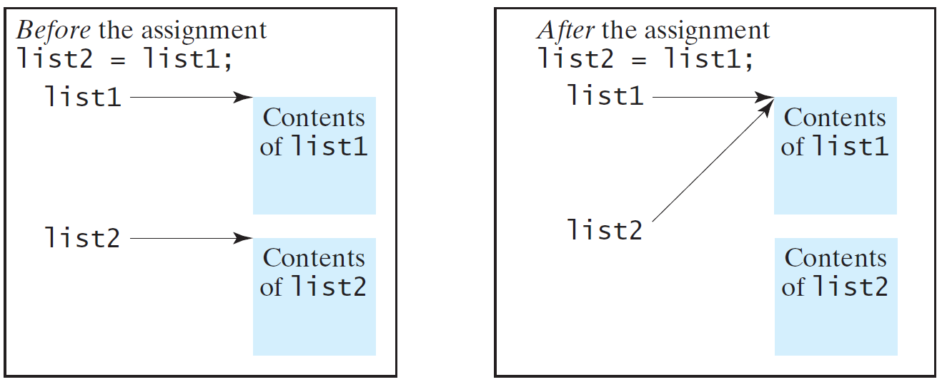
Copying Arrays
Often, in a program, you need to duplicate an array or a part of an array. In such cases you could attempt to use the assignment statement (=), as follows:
list2 = list1;

Slide 32
Copying Arrays
Using a loop:
int[] sourceArray = {2, 3, 1, 5, 10};
int[] targetArray = new int[sourceArray.length];
for (int i = 0; i < sourceArrays.length; i++)
targetArray[i] = sourceArray[i];

Slide 33
The arraycopy Utility
arraycopy(sourceArray, src_pos, targetArray, tar_pos, length);
Example:
System.arraycopy(sourceArray, 0, targetArray, 0, sourceArray.length);

Slide 34
Passing Arrays to Methods
public static void printArray(int[] array) {
for (int i = 0; i < array.length; i++) {
System.out.print(array[i] + " ");
}
}
Invoke the method
int[] list = {3, 1, 2, 6, 4, 2};
printArray(list);
Invoke the method
printArray(new int[]{3, 1, 2, 6, 4, 2});
Anonymous array

Slide 35
Pass By Value
Java uses pass by value to pass arguments to a method. There are important differences between passing a value of variables of primitive data types and passing arrays.
For a parameter of a primitive type value, the actual value is passed. Changing the value of the local parameter inside the method does not affect the value of the variable outside the method.
For a parameter of an array type, the value of the parameter contains a reference to an array; this reference is passed to the method. Any changes to the array that occur inside the method body will affect the original array that was passed as the argument.

Slide 36
Simple Example
public class Test {
public static void main(String[] args) {
int x = 1; // x represents an int value
int[] y = new int[10]; // y represents an array of int values
m(x, y); // Invoke m with arguments x and y
System.out.println("x is " + x);
System.out.println("y[0] is " + y[0]);
}
public static void m(int number, int[] numbers) {
number = 1001; // Assign a new value to number
numbers[0] = 5555; // Assign a new value to numbers[0]
}
}

Slide 37
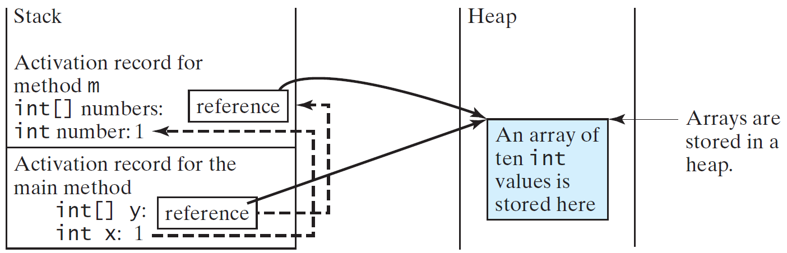
Call Stack
When invoking m(x, y), the values of x and y are passed to number and numbers. Since y contains the reference value to the array, numbers now contains the same reference value to the same array.

Slide 38
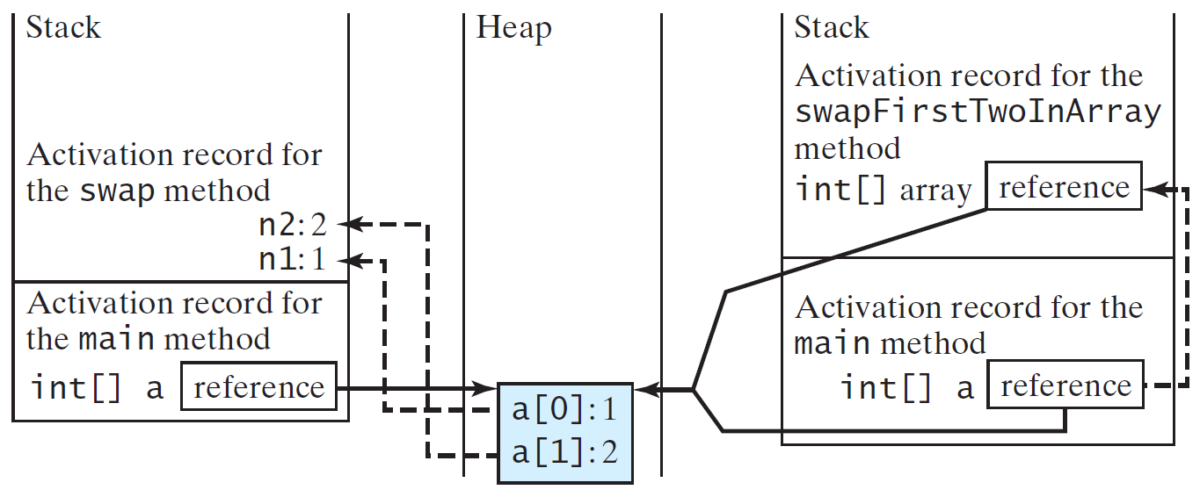
Call Stack
When invoking m(x, y), the values of x and y are passed to number and numbers. Since y contains the reference value to the array, numbers now contains the same reference value to the same array.

Slide 39
Heap
The JVM stores the array in an area of memory, called heap, which is used for dynamic memory allocation where blocks of memory are allocated and freed in an arbitrary order.

Slide 40
Returning an Array from a Method
public static int[] reverse(int[] list) {
int[] result = new int[list.length];
for (int i = 0, j = result.length - 1;
i < list.length; i++, j--) {
result[j] = list[i];
}
return result;
}
list
result
int[] list1 = {1, 2, 3, 4, 5, 6};
int[] list2 = reverse(list1);

Slide 41
Trace the reverse Method
animation
int[] list1 = {1, 2, 3, 4, 5, 6};
int[] list2 = reverse(list1);
Declare result and create array
public static int[] reverse(int[] list) {
int[] result = new int[list.length];
for (int i = 0, j = result.length - 1;
i < list.length; i++, j--) {
result[j] = list[i];
}
return result;
}
list
1
2
3
4
5
6
result
0
0
0
0
0
0

Slide 42
Trace the reverse Method, cont.
animation
int[] list1 = {1, 2, 3, 4, 5, 6};
int[] list2 = reverse(list1);
Return result
public static int[] reverse(int[] list) {
int[] result = new int[list.length];
for (int i = 0, j = result.length - 1;
i < list.length; i++, j--) {
result[j] = list[i];
}
return result;
}
list
1
2
3
4
5
6
list2
result
6
5
4
3
2
1

Slide 43
Typical Example of Array
Search
Sort

Slide 44
Searching Arrays
Searching is the process of looking for a specific element in an array; for example, discovering whether a certain score is included in a list of scores. Searching is a common task in computer programming. There are many algorithms and data structures devoted to searching. In this section, two commonly used approaches are discussed, linear search and binary search.

Slide 45
Linear Search
The linear search approach compares the key element, key, sequentially with each element in the array list. The method continues to do so until the key matches an element in the list or the list is exhausted without a match being found. If a match is made, the linear search returns the index of the element in the array that matches the key. If no match is found, the search returns -1.

Slide 46
Binary Search
For binary search to work, the elements in the array must already be ordered. Without loss of generality, assume that the array is in ascending order.
e.g., 2 4 7 10 11 45 50 59 60 66 69 70 79
The binary search first compares the key with the element in the middle of the array.

Slide 47
Binary Search, cont.
Consider the following three cases:
If the key is less than the middle element, you only need to search the key in the first half of the array.
If the key is equal to the middle element, the search ends with a match.
If the key is greater than the middle element, you only need to search the key in the second half of the array.

Slide 48
Binary Search
animation
Key
List
8
1 | 2 | 3 | 4 | 6 | 7 | 8 | 9
8
1 | 2 | 3 | 4 | 6 | 7 | 8 | 9
8
1 | 2 | 3 | 4 | 6 | 7 | 8 | 9

Slide 49
From Idea to Soluton
/** Use binary search to find the key in the list */
public static int binarySearch(int[] list, int key) {
int low = 0;
int high = list.length - 1;
while (high >= low) {
int mid = (low + high) / 2;
if (key < list[mid])
high = mid - 1;
else if (key == list[mid])
return mid;
else
low = mid + 1;
}
return -1 - low;
}

Slide 50
The Arrays.binarySearch Method
Since binary search is frequently used in programming, Java provides several overloaded binarySearch methods for searching a key in an array of int, double, char, short, long, and float in the java.util.Arrays class. For example, the following code searches the keys in an array of numbers and an array of characters.
int[] list = {2, 4, 7, 10, 11, 45, 50, 59, 60, 66, 69, 70, 79};
System.out.println("Index is " +
java.util.Arrays.binarySearch(list, 11));
char[] chars = {'a', 'c', 'g', 'x', 'y', 'z'};
System.out.println("Index is " +
java.util.Arrays.binarySearch(chars, 't'));
For the binarySearch method to work, the array must be pre-sorted in increasing order.
Return is 4
Return is –4 (insertion point is 3, so return is -3-1)

Slide 51
Sorting Arrays
Sorting, like searching, is also a common task in computer programming. Many different algorithms have been developed for sorting. This section introduces a simple, intuitive sorting algorithms: selection sort.

Slide 52
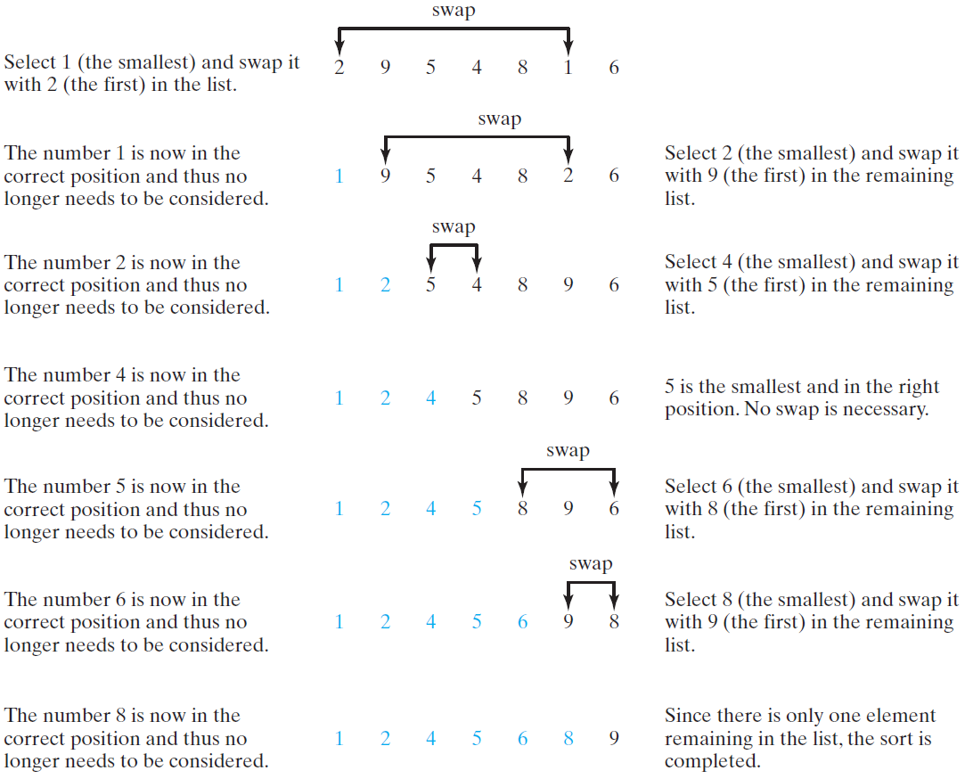
Selection Sort
Selection sort finds the smallest number in the list and places it first. It then finds the smallest number remaining and places it second, and so on until the list contains only a single number.

Slide 53
Expand
for (int i = 0; i < listSize; i++) {
select the smallest element in list[i..listSize-1];
swap the smallest with list[i], if necessary;
// list[i] is in its correct position.
// The next iteration apply on list[i..listSize-1]
}
double currentMin = list[i];
int currentMinIndex = i;
for (int j = i; j < list.length; j++) {
if (currentMin > list[j]) {
currentMin = list[j];
currentMinIndex = j;
}
}

Slide 54
Expand
for (int i = 0; i < listSize; i++) {
select the smallest element in list[i..listSize-1];
swap the smallest with list[i], if necessary;
// list[i] is in its correct position.
// The next iteration apply on list[i..listSize-1]
}
if (currentMinIndex != i) {
list[currentMinIndex] = list[i];
list[i] = currentMin;
}

Slide 55
Wrap it in a Method
/** The method for sorting the numbers */
public static void selectionSort(double[] list) {
for (int i = 0; i < list.length; i++) {
// Find the minimum in the list[i..list.length-1]
double currentMin = list[i];
int currentMinIndex = i;
for (int j = i + 1; j < list.length; j++) {
if (currentMin > list[j]) {
currentMin = list[j];
currentMinIndex = j;
}
}
// Swap list[i] with list[currentMinIndex] if necessary;
if (currentMinIndex != i) {
list[currentMinIndex] = list[i];
list[i] = currentMin;
}
}
}
Invoke it
selectionSort(yourList)

Slide 56
The Arrays.sort Method
Since sorting is frequently used in programming, Java provides several overloaded sort methods for sorting an array of int, double, char, short, long, and float in the java.util.Arrays class. For example, the following code sorts an array of numbers and an array of characters.
double[] numbers = {6.0, 4.4, 1.9, 2.9, 3.4, 3.5};
java.util.Arrays.sort(numbers);
char[] chars = {'a', 'A', '4', 'F', 'D', 'P'};
java.util.Arrays.sort(chars);
Java 8 now provides Arrays.parallelSort(list) that utilizes the multicore for fast sorting.

